Slide 1
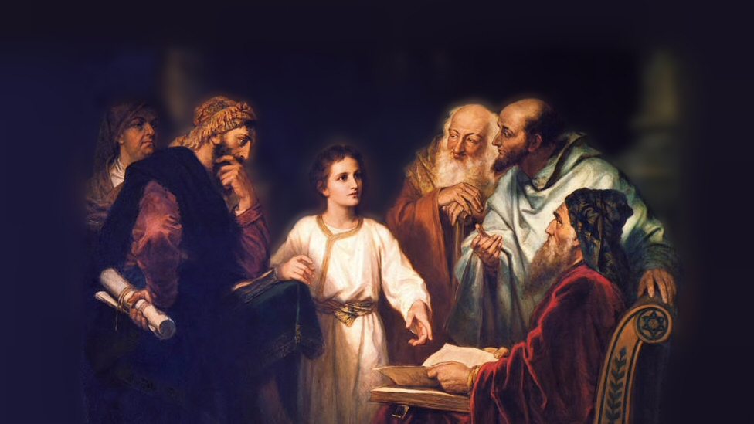
About My Father’s Business
Healing on the Sabbath Day
(Luke 14:1-6)
Notes:
(Luke 14:1-6), “Now it happened, as He went into the house of one of the rulers of the Pharisees to eat bread on the Sabbath, that they watched Him closely. ² And behold, there was a certain man before Him who had dropsy. ³ And Jesus, answering, spoke to the lawyers and Pharisees, saying, “Is it lawful to heal on the Sabbath?” ⁴ But they kept silent. And He took him and healed him, and let him go. ⁵ Then He answered them, saying, “Which of you, having a donkey or an ox that has fallen into a pit, will not immediately pull him out on the Sabbath day?” ⁶ And they could not answer Him regarding these things.”
This passage is an interesting one for several reasons, NOTE:
The illness (dropsy). The accumulation of fluids in the body (edema, swelling). With the limited medical knowledge they had, the cause of such swelling (kidney or heart disease) could not be determined or healed.
Nothing is known about the man himself, or why he was there.
Was he there as a trap, placed by the Pharisees to give reason to accuse Jesus?
Or, did Jesus simply use his presence as an opportunity to confront the Pharisees
The location. Why was Jesus in the house of a ruler of the Pharisees? Was this a public occasion? Had he been invited? It is obvious that these men had no respect for our Savior
The Miracle here (though it again established the divine power of Jesus) is secondary to the questions Jesus asked with regard to the Sabbath day. Not that after He healed him, He let him go. Jesus’ attention was on the Pharisees.
Jesus here (as always) exhibited a mastery of the situation.
The best way to handle this narrative is to take it in order, and discuss some relevant points to gain some helpful truths from our study… So, note verse 1
Picture attribution: More Good Foundation (cropped, with background blurred) Creative Commons Liscense
https://www.flickr.com/photos/moregoodfoundation/5135438113

Slide 2
The Watchful Pharisees (1)
“one of the rulers of the Pharisees”
“to eat bread on the Sabbath”
“they watched Him closely”
(cf. Matthew 16:1; Luke 11:53-54)
Notes:
Jesus went into the house of one of the “chief” Pharisees
Chief (KJV) Ruler (NKJV) Leader (NASB) Prominent (NIV) – (Perhaps a ruler of the synagogue there, or a local judge, or influential person). There is no contextual information regarding where this event occurred.
It was the Sabbath Day (A day of worship, and rest under the Old Law)
“they watched Him closely”
There is significance in this phrase
Thayer: 1) to stand beside and watch, to watch assiduously, observe carefully
1a) to watch, attend to with the eyes
1b) in a bad sense, to watch insidiously
1c) to watch one’s self
1b) to observe, keep scrupulously
1b1) to neglect nothing requisite to the religious observance of
If not in the definition of the term, the context clearly shows their intent was evil.
Other examples of such malicious intent found throughout the gospels
(Matthew 16:1), “Then the Pharisees and Sadducees came, and testing Him asked that He would show them a sign from heaven.”
(Luke 11:53-54), [After He upbraided them for their unrighteousness], “And as He said these things to them, the scribes and the Pharisees began to assail Him vehemently, and to cross-examine Him about many things, ⁵⁴ lying in wait for Him, and seeking to catch Him in something He might say, that they might accuse Him.”

Slide 3
Jesus’’ Question & The Response (3-4)
“And Jesus, answering, spoke…”
(cf. Matthew 12:9-14)
“Is it lawful to heal on the Sabbath?”
(Exodus 20:8-11)
“But they kept silent.”
(cf. Matthew 21:25-27)
Notes:
The word “answering” here is interesting…
Thayer – literally indicates a response. Used in scripture on certain occasions as Jesus (who knew the hearts of his enemies) actually provoked the exchange to make his point. (Answering what He knew was in their minds)
Consider that there is a very similar event which showed the Pharisees true colors
(Matthew 12:9-14), “Now when He had departed from there, He went into their synagogue. ¹⁰ And behold, there was a man who had a withered hand. And they asked Him, saying, “Is it lawful to heal on the Sabbath?”—that they might accuse Him. ¹¹ Then He said to them, “What man is there among you who has one sheep, and if it falls into a pit on the Sabbath, will not lay hold of it and lift it out? ¹² Of how much more value then is a man than a sheep? Therefore it is lawful to do good on the Sabbath.” ¹³ Then He said to the man, “Stretch out your hand.” And he stretched it out, and it was restored as whole as the other. ¹⁴ Then the Pharisees went out and plotted against Him, how they might destroy Him.”
Working was forbidden on the Sabbath Day. (Note: Jesus’ question was a point of conflict with the Pharisees, (Luke 6:9; 13:10-17; Mt. 12; Here) The Prohibition of working was well known.
(Exodus 20:8-11), “Remember the Sabbath day, to keep it holy. ⁹ Six days you shall labor and do all your work, ¹⁰ but the seventh day is the Sabbath of the Lord your God. In it you shall do no work: you, nor your son, nor your daughter, nor your male servant, nor your female servant, nor your cattle, nor your stranger who is within your gates. ¹¹ For in six days the Lord made the heavens and the earth, the sea, and all that is in them, and rested the seventh day. Therefore the Lord blessed the Sabbath day and hallowed it.”
From other passages, and our context, Jesus knew they objected, but here, they refused to answer His question.
There was no response they could give that would benefit them!
If they said yes, it would violate their strict (but erroneous) interpretation of what constitutes work on the Sabbath
If they said no, it would paint them as uncaring as their might be an opportunity to help a suffering man. The law gave provision for humane response and mercy on the Sabbath day.
NOT RESPONDING meant that any future criticism would be hypocritical. He gave them an opportunity to speak on the subject, but they were only interested in tactical advantage, not truth!
This is the corrupt character of these men. They were interested in power, not truth!
(Matthew 21:25-27), [Chief priests asked Jesus, re: his teaching, “By what authority as your doing these things?” Jesus responded with his own question. He would answer if they would], “The baptism of John—where was it from? From heaven or from men?” And they reasoned among themselves, saying, “If we say, ‘From heaven,’ He will say to us, ‘Why then did you not believe him?’ ²⁶ But if we say, ‘From men,’ we fear the multitude, for all count John as a prophet.” ²⁷ So they answered Jesus and said, “We do not know.”

Slide 4
Jesus’’ 2nd Question & The Response (5-6)
“Which of you, having a donkey or an ox that has fallen into a pit, will not immediately pull him out on the Sabbath day?
(cf. Matthew 12:12; Deuteronomy 22:1-4)
“And they could not answer Him...”
(Titus 1:10-11; Acts 3:19)
Notes:
This question was asked immediately after healing the man of his illness. Now, as in the past, there would be an opportunity to accuse him. But, the accusation left them open to a charge of hypocrisy!
The Pharisees acknowledged that the law allowed them to “do good” on the Sabbath day
(Matthew 12:12) [Jesus arguing what they themselves affirmed, and in Jesus’ words, what they practiced], “Therefore it is lawful to do good on the Sabbath.”
(Deuteronomy 22:1-4), “You shall not see your brother's ox or his sheep going astray, and hide yourself from them; you shall certainly bring them back to your brother. ² And if your brother is not near you, or if you do not know him, then you shall bring it to your own house, and it shall remain with you until your brother seeks it; then you shall restore it to him. ³ You shall do the same with his donkey, and so shall you do with his garment; with any lost thing of your brother's, which he has lost and you have found, you shall do likewise; you must not hide yourself. ⁴ “You shall not see your brother's donkey or his ox fall down along the road, and hide yourself from them; you shall surely help him lift them up again.”
Note: While the first time they refused to commit themselves, the self-contradictory nature of their view on the Sabbath was so evident now they could not answer him. To do so would expose their own hypocrisy.
The only sufficient answer would be, “You are right, we are being inconsistent in this, it is lawful to heal on the Sabbath.” This they would not admit!
The preaching of truth does two things:
First, it stops the mouths of the false teachers (though they will not repent, their influence is stopped)
(Titus 1:10-11), [the task of the elder], “For there are many insubordinate, both idle talkers and deceivers, especially those of the circumcision, ¹¹ whose mouths must be stopped, who subvert whole households, teaching things which they ought not, for the sake of dishonest gain.”
Second, it convicts the hearts of those who are honest!
(Acts 3:19), [Peter, preaching at Solomon’s porch to the Jews in Jerusalem], “Repent therefore and be converted, that your sins may be blotted out, so that times of refreshing may come from the presence of the Lord.”

Slide 5
Applications to Consider
We must always handle the word of truth with honesty (a good heart) (Luke 8:15)
Our obedience of God’s laws is never an excuse to ignore the suffering of men! (Matthew 15:6-9; 2 Timothy 2:15)
Notes:
(Luke 8:15), [Jesus’ explanation of the parable of the sower], “But the ones [seeds] that fell on the good ground are those who, having heard the word with a noble and good heart, keep it and bear fruit with patience.”
Like our text: You can’t heal this man, it is the Sabbath day!
Or, like those who gave to the temple what should have been given to honor their parents
(Matthew 15:6-9), “Thus you have made the commandment of God of no effect by your tradition. ⁷ Hypocrites! Well did Isaiah prophesy about you, saying: ⁸ ‘These people draw near to Me with their mouth, and honor Me with their lips, but their heart is far from Me. ⁹ And in vain they worship Me, teaching as doctrines the commandments of men.’”
Some people think that we can simply disregard God’s instructions or laws (That is Wrong)
Some people think they can USE God’s laws to gain advantage (looking for loopholes) (That too is Wrong)
(2 Timothy 2:15), “Be diligent to present yourself approved to God, a worker who does not need to be ashamed, rightly dividing the word of truth.”

